Slide 1
Smart Phones on Twitter
Web analytic course Spring2013
Prof. Winter Mason
Presented by:
Ebrahim Safavi
Mahdi Azarafrooz
Alireza Louni

Slide 2
Outline
Introduction
Motivation and Goals
Data Acquisition and Cleaning
Market Analysis
Perceptual Map
Summary

Slide 3

Introduction
Big data
Web 2
Tons of data on social networks by members.
Novel polling for market purposes.
Twitter introduction
Micro-blogging
Text-based interaction
Stream of tweets

Slide 4
Motivation and Goals
Fast changing market
Fully competitive market
Why Twitter?
Easy access and free
Customer expectation and interests
Strategic plan

Slide 5
Data Acquisition and Cleaning
Python-Twitter Package
6000 Tweets
Saved as JSON
Irrelevant Tweets
Linguistic Analysis

Slide 6
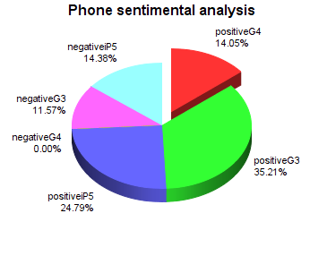
Market Analysis

Slide 7
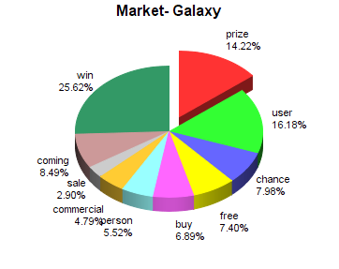
Market Analysis
Linguistic Analysis
Market Game
Market
Hardware
Software
Appearance
Competitors

Slide 8
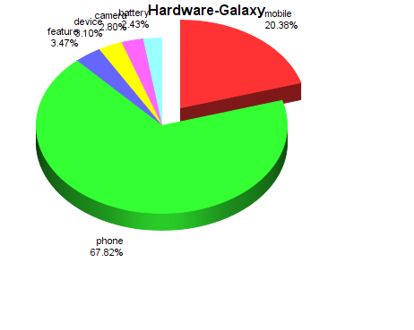
Market Analysis
Market Game
Market
Hardware
Software
Appearance
Competitors

Slide 9
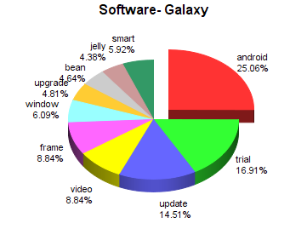
Market Analysis
Market Game
Market
Hardware
Software
Appearance
Competitors

Slide 10
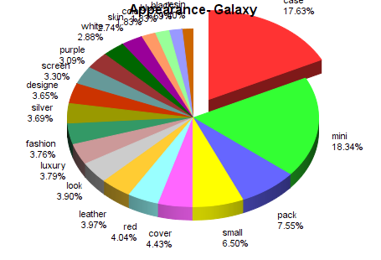
Market Analysis
Market Game
Market
Hardware
Software
Appearance
Competitors

Slide 11
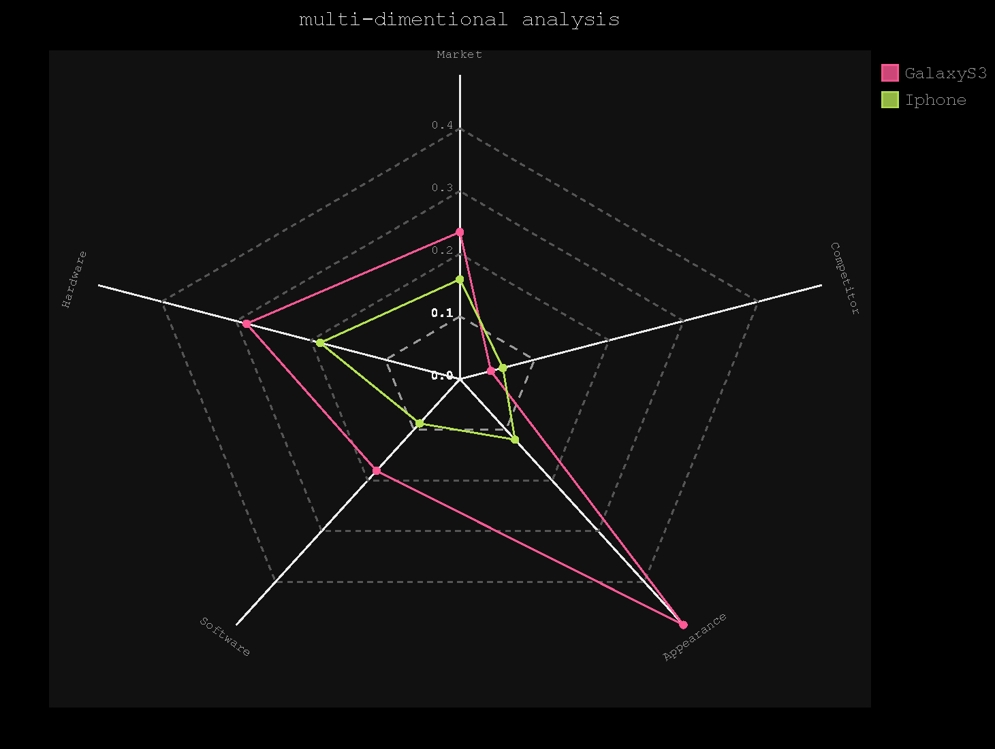
Perceptual Map

Slide 12
Co-occurrence Analysis
correlation=0.3
samsung eyebased nyt scrolling tout
0.46 0.31 0.31 0.31 0.31
correlation=0.2
samsung eyebased nyt scrolling tout iii iiis
0.46 0.31 0.31 0.31 0.31 0.30 0.30
siii vaunted features
0.29 0.28 0.21
correlation=0.1
samsung eyebased nyt scrolling tout iii iiis
0.46 0.31 0.31 0.31 0.31 0.30 0.30
siii vaunted features note lte fcc passes
0.29 0.28 0.21 0.15 0.14 0.13 0.13
pages support tmobile eyes scroll kept samsungs
0.12 0.12 0.12 0.11 0.11 0.10 0.10
Galaxy S III- Galaxy S3 -Galaxy SIII -GalaxyS3 -GalaxySIII
These words co-occur frequently with “Galaxy”

Slide 13
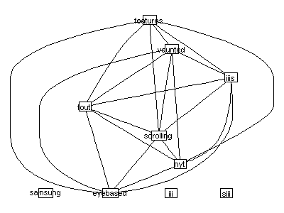
Data Visualization
We'll draw lines between those terms if they are correlated
Correlation with Galaxy=.2 and correlation for edge formation=.3

Slide 14
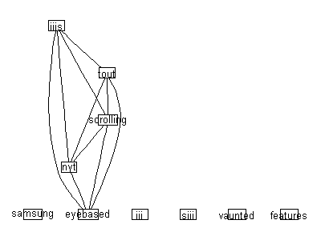
Data Visualization
Correlation with Galaxy=.2 and correlation for edge formation=.9

Slide 15
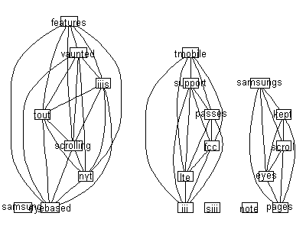
Data Visualization
Correlation with Galaxy=.1 and correlation for edge formation=.3

Slide 16
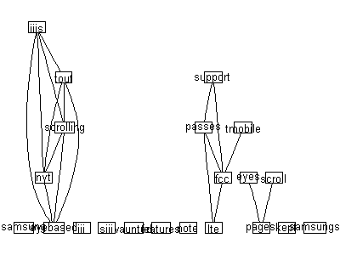
Correlation with Galaxy=.1 and correlation for edge formation=.3

Slide 17
Summary
Big-data
Data acquisition
Market perspective
Perceptual analysis

